Slide 1
MMDetection Framework
By: Fityanul Akhyar
Teacher: Professor. Chih-Yang Lin

Slide 2
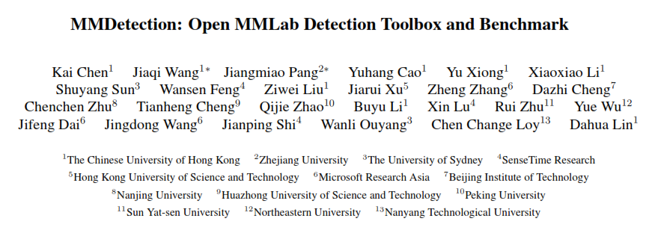
Source
Paper: https://arxiv.org/pdf/1906.07155.pdf
Github: https://github.com/open-mmlab/mmdetection

Slide 3
How to install
Requirements
Linux or macOS (Windows is not currently officially supported)
Python 3.6+
PyTorch 1.3+
CUDA 9.2+ (If you build PyTorch from source, CUDA 9.0 is also compatible)
GCC 4.9+
mmcv

Slide 4
How to install
#Create environment
conda create -n open-mmlab python=3.7 -y
conda activate open-mmlab
#Install pytorch
conda install pytorch torchvision cudatoolkit=10.2 -c pytorch
#Clone the mmdetection repository
git clone https://github.com/open-mmlab/mmdetection.git
cd mmdetection

Slide 5
How to install
#Install build requirements and then install mmdetection
pip install -r requirements/build.txt
pip install "git+https://github.com/cocodataset/cocoapi.git#subdirectory=PythonAPI"
pip install -v -e . # or "python setup.py develop"

Slide 6
How to use
#Train model
python tools/train.py ${CONFIG_FILE} [optional arguments]
Example:
python tools/train.py configs/faster_rcnn_r50_fpn_1x.py –validate
#Test model
python tools/test.py ${CONFIG_FILE} ${CHECKPOINT_FILE} [--out ${RESULT_FILE}] [--eval ${EVAL_METRICS}]
Example:
python tools/test.py configs/faster_rcnn_r50_fpn_1x.py work_dirs/ faster_rcnn_r50_fpn_1/epoch_17.pth --eval mAP

Slide 7

Custom config file
#Choose the config file
Example:
configs/faster_rcnn/faster_rcnn_r50_fpn_1x_coco.py
#Use custom dataset at the config file

Slide 8
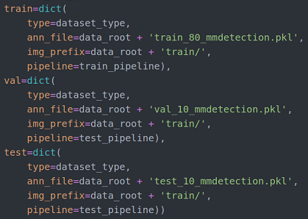
Custom config file
#Change directory location
#Use mAP for evaluation metric

Slide 9
mAP target
Models | Backbone | REC-1 | REC-2 | REC-3 | REC-4 | AP-1 | AP-2 | AP-3 | AP-4 | mAP
Faster R-CNN | ResNet-50-FPN | 0.756 | 0.850 | 0.879 | 0.891 | 0.531 | 0.746 | 0.636 | 0.700 | 0.653
 | ResNet-101-FPN | 0.709 | 0.850 | 0.881 | 0.875 | 0.529 | 0.787 | 0.682 | 0.719 | 0.679
 | ResNeXt-101 (32x4d)-FPN | 0.744 | 0.800 | 0.883 | 0.922 | 0.546 | 0.753 | 0.691 | 0.715 | 0.676
 | ResNeXt-101 (64x4d)-FPN | 0.756 | 0.850 | 0.865 | 0.844 | 0.591 | 0.762 | 0.670 | 0.669 | 0.673

Slide 10
Where to download dataset
https://drive.google.com/file/d/1UB_8zzQrW0-6K35Wu-CLYD0j0HiEGuKJ/view?usp=sharing

Slide 11
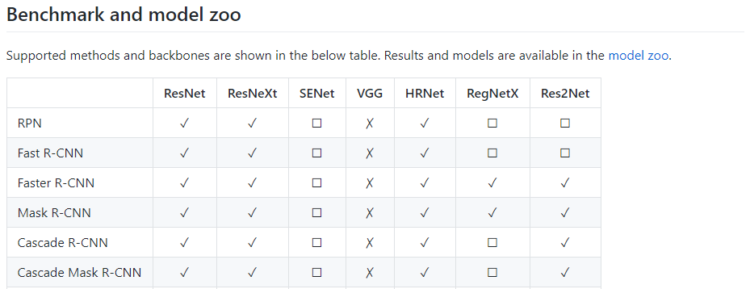
Facilities

Slide 12
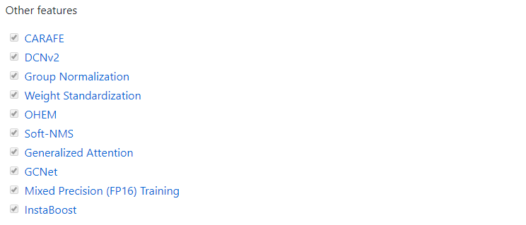
Facilities

Slide 13
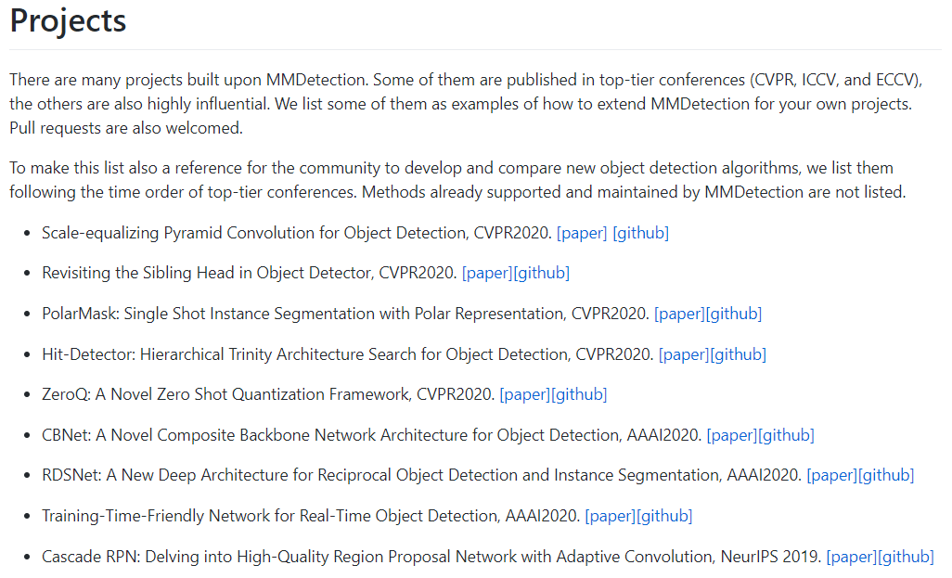
Examples

Slide 14
How to improve…
Models | Improvement | REC-1 | REC-2 | REC-3 | REC-4 | AP-1 | AP-2 | AP-3 | AP-4 | mAP
Cascade R-CNN ResNeXt-101 (32x4d)-FPN | + multi scale train | 0.709 | 0.900 | 0.854 | 0.891 | 0.557 | 0.852 | 0.700 | 0.733 | 0.711
 | + multi scale test | 0.814 | 0.850 | 0.890 | 0.953 | 0.672 | 0.752 | 0.751 | 0.790 | 0.741
 | + deformable conv | 0.849 | 0.850 | 0.898 | 0.906 | 0.719 | 0.752 | 0.800 | 0.789 | 0.765
 | + guide anchoring | 0.872 | 0.850 | 0.903 | 0.953 | 0.700 | 0.820 | 0.820 | 0.872 | 0.803

Slide 15
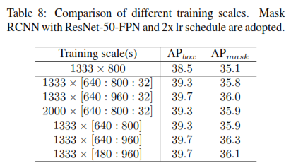
Multi-scale
#Source:
MMDetection: Open MMLab Detection Toolbox and Benchmark.
https://arxiv.org/abs/1906.07155

Slide 16
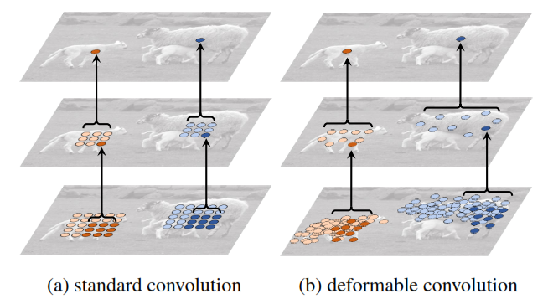
Deformable Convolution
“We add deformable convolution in resnet stage 3 to 5 (DCN S3-S5).”
Source: Deformable Convolutional Networks. Jifeng Dai .et. al. ICCV 2017.
http://openaccess.thecvf.com/content_ICCV_2017/papers/Dai_Deformable_Convolutional_Networks_ICCV_2017_paper.pdf

Slide 17
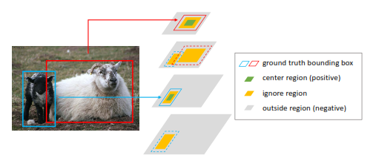
Guide Anchoring
“Anchor location target for multi-level features. We assign ground truth objects to different feature levels according to their scales, and deﬁne CR; IR and OR respectively.”
Source: Region proposal by guided anchoring. Jiaqi Wang .et. al. CVPR 2019.
http://openaccess.thecvf.com/content_CVPR_2019/papers/Wang_Region_Proposal_by_Guided_Anchoring_CVPR_2019_paper.pdf

Slide 18
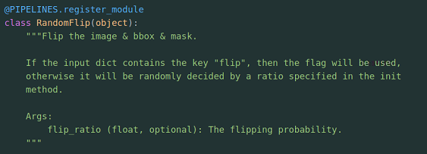
How to use augmentation…
First way, use standard Mmdetection
Find the augmentation feature at:
Training augmentation: mmdetection/mmdet/datasets/pipelines/transform.py
Testing augmentation: mmdetection/mmdet/datasets/pipelines/test_aug.py
For example (Random Flip at transform.py):

Slide 19
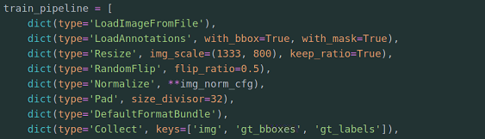
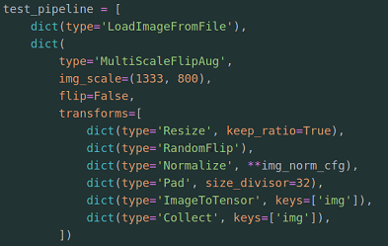
How to use augmentation…
First way, use standard Mmdetection
Use Random Flip in config file:

Slide 20
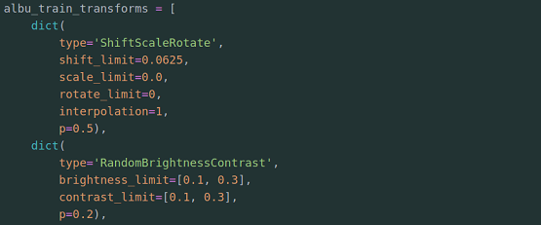
How to use augmentation…
Second way, use Albumentation
Find the configuration example at:
Testing augmentation: mmdetection/configs/albu_example/mask_rcnn_r50_fpn_1x.py
See detail at the file how to use in config file:

Slide 21
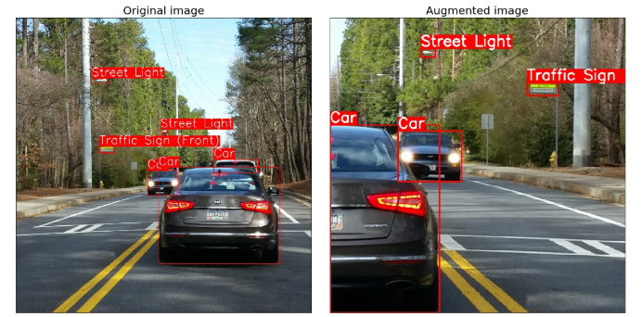
How to use augmentation…
Second way, use Albumentation
Study more details about Albumentation from this paper:
Albumentations: Fast and Flexible Image Augmentations https://www.mdpi.com/2078-2489/11/2/125

Slide 22
Thank You

